Slide 1
THE TRANS-GENERATIONAL LEADER (Session One)

Slide 2
INTRODUCTION
Today’s world and even the church is multi-generational.
As such, we need to develop leaders that are trans-generational.

Slide 3
WHO IS A TRANS-GENERATIONAL LEADER?
A leader who understands and can work with the different generations that constitutes today’s church.
A trans-generational leader is someone who has developed what is referred to as a GENERATIONAL INTELLIGENCE (GQ)

Slide 4
GENERATIONAL INTELLIGENCE (GQ)
Generational Intelligence (GQ) is defined “…as the capability required to leverage an age-diverse workforce (or church congregation)…” Poornima Luthra, World Economic Forum, Feb, 2019.
Generational Intelligence also means “…raising your awareness of cross generational interactions…” Amy Lynch, 2020.

Slide 5
WHY DO WE NEED TRANS-GENERATIONAL LEADERS?
There is a generational shift occurring and this could be a source of generational conflict hence, the need to improve our GQ in ensuring we fulfill the mandate of this commission.
One of the biggest reasons for generational conflict is that older and younger generations misinterpret each other’s behaviour.

Slide 6
MEANING OF GENERATION
Generation can be defined as “…a group of people born in the same era, shaped by the same times and influenced by the same social markers…” Mark McCrindle, 2011.

Slide 7
THE DIFFERENT GENERATION CLASSES
VETERANS
BABY BOOMERS
GEN-X
GEN-Y
GEN-Z
ALPHA GENERATION

Slide 8
DESCRIBING THE VETERANS

Slide 9
Describing The Baby Boomers

Slide 10
Describing The GEN-X

Slide 11
Describing The GEN-Y

Slide 12
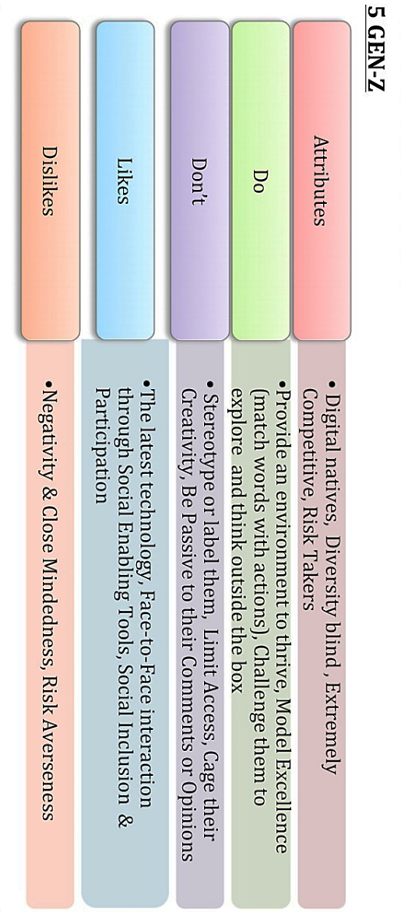
Describing The GEN-Z

Slide 13
Leadership Preferences the Veterans
By statistics, they are born before 1946.
Most of the people in this generation have retired from the workforce. However, their experience and expertise is still in need in various areas of endeavours.

Slide 14
LEADERSHIP PREFERENCES BABY BOOMERS
Born between 1946 and 1964, these generation still accounts for roughly one-third (31%) of the workforce.
They are leaders that model right behaviours and can be trusted as well as loyal to those that have their back.

Slide 15
LEADERSHIP PREFERENCES THE GEN-X
Born between 1965 and 1979, they account for 32% off the workforce.
They are straight-forward, genuine and “hands-off” in their leadership approach.

Slide 16
LEADERSHIP PREFERENCES THE GEN-Y
Born between 1980 and 1994, they account for 34% of the workforce. By 2025, they will represent 75% of global workforce.
They are leaders who are enablers and create opportunities for growth and meaningful work. Also they give developmental feedback.

Slide 17
LEADERSHIP PREFERENCES THE GEN-Z
Born between 1996 and 2010, this generation is just entering the workforce.
They are leaders who are connected and whose digital footprint is aspirational. They seek inspirational leaders.

Slide 18
Comparing The Different Generations

Slide 19
CHARACTERISTICS OF GEN-ALPHA YOU NEED TO CONSIDER
They will be the most educated Generation in history.
They are tech-savvy.
AI (Artificial Intelligence) is their reality.
Social media will be their dominant mode of interaction.
They don’t play by the rules.
They are constantly changing.
They live at the moment.
They are trendy.

Slide 20
HOW TO ENGAGE THE DIFFERENT GENERATIONS
Educate
Empathize
Engage
Encourage
Enable

Slide 21
TIPS TO BEING AN EFFECTIVE LISTENER.
Set aside your own agenda.
Be available and receptive emotionally as well as through body language.
Try to appreciate the other person’s point of view.
Listen without being in a hurry to take over.
Try to imagine yourself in the other person’s place; feel what the speaker feels.
Help draw out thought and feeling by asking questions.
Have the speaker elaborate for further understanding.
Say, “let me make sure I understand.” and then restate the issue.
Be sensitive to the speaker’s feelings.

