Slide 1
EXPONENTIAL
THE TRANS-GENERATIONAL LEADER: PART 2
BY
DCN. IDONGESIT OKONETUK

Slide 2
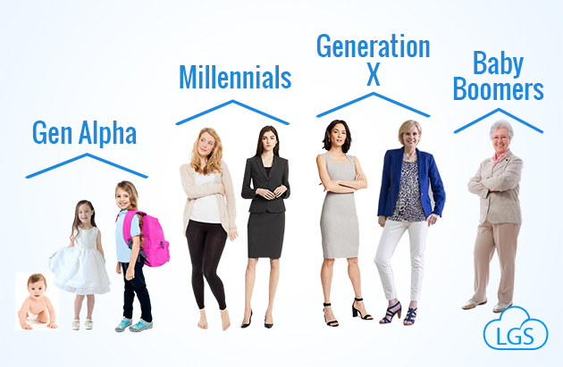
THE DIFFERENT AGE GENERATIONS

Slide 3

2 ASPECTS OF THE DEFINITION OF THE TRANS-GENERATIONAL LEADER

Slide 4
THE RELEVANCE OF THE TEACHING
TO UNDERSCORE THE ROLE OF THE TRANS-GENERATIONAL LEADER IN THE EXPONENTIAL GROWTH OF THE CHURCH OR ANY ORGANIZATION.
TO EQUIP LEADERS WITH THE NEEDED SKILLS AND CAPACITIES TO BE EFFECTIVE TRANS-GENERATIONAL LEADERS.
TO PREPARE WOULD-BE LEADERS FOR THE LEADERSHIP ROLE AHEAD.
TO EMPHASIZE THE IMPORTANCE OF SUCCESSION PLANNING.

Slide 5
ATTRIBUTES OF THE TRANS-GENERATIONAL LEADER
OPEN MINDED
CONTEMPORARY
VISIONARY
UTILITARIAN
EMPATHETIC
INTEGRITY
LEGACY

Slide 6
WHAT ARE THE REWARDS FOR SERVICE
SELF-WORTH
FULFILMENT OF PURPOSE
PROMOTION TO HIGHER SERVICE
FAVOURS/COMMERCIAL ENGAGEMENT/FINANCIAL REWARD
GOD’S BLESSING
LASTING LEGACY

Slide 7
A CALL FOR SERVICE
MAKE YOURSELF AVAILABLE
JUST THE WAY YOU ARE
ANY SERVICE IS ENOUGH
YOUR BEST FAITHFUL EFFORTS AND NOT YOUR BLOOD

Slide 8
YOU HAVE JUST BEEN INVITED TO BE A TRANS-GENERATIONAL LEADER
THANK YOU FOR LISTENING

