Slide 1
EXPONENTIAL:
The Multiplication Challenge
TREM Leadership Series For The Month Of February 2021

Slide 2
THE LEADER AS A MULTIPLIER: Session 4
Taken by
Victor Ben

Slide 3
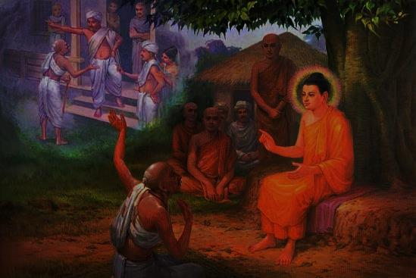
Multiplier 4: Internship
Apprenticeship and mentorship – (Jn.3:22 NIV)
Engagement= proximity
Spent time= Tarried (KJV)= Rub off on(Greek)
Not about spending hours & minutes. It was DIATRIBO
Mark 3:13-15(AMPC), RESULT:Acts17:6(ESV)

Slide 4
1) Disciple multipliers start with few, not many- Mark 3:13-14
Application

Slide 5
2) Disciple multipliers prioritize relationships, not curriculum- Mark 3:14
Application

Slide 6
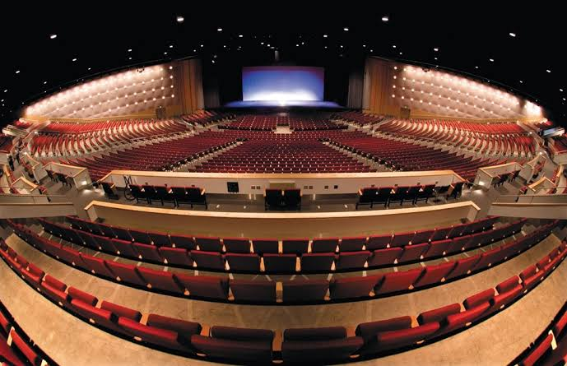
3) Disciple multipliers focus on sending capacity over seating capacity- Mark 3:14-15
Application

Slide 7
4) Disciple multipliers hands off authority rather than hold on to it- Mark 3:15
Application

Slide 8
Multiplier 5: Integration
Knowledge
Experiences
Coaching

Slide 9
Thank You

Slide 10
ASK
QUESTION

Slide 11
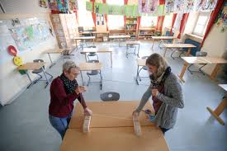
LET’S GO
PRACTICAL

